Slide 1
Dating Application
Nivedha Balakrishnan
Rahul Reddy Parupati
Sathvick Reddy Narahari

Slide 2
Why?
Even though there are a lot of dating apps , all of these apps mostly focus on superficial features and most features are paid features.
This makes the entire process of online dating difficult.
54% of Users worldwide are looking for a compatible partner through dating apps.
We wanted to know how users were feeling about this by performing analysis on the reviews written.

Slide 3
Stats
Online dating revenue in USA: 602 Million USD
Number of online dating users in USA: 44.2 Million
Share of U.S. online dating users who went on a date with someone they had met online:77%
Source:
https://www.statista.com/topics/2158/online-dating/#topicHeader__wrapper

Slide 4
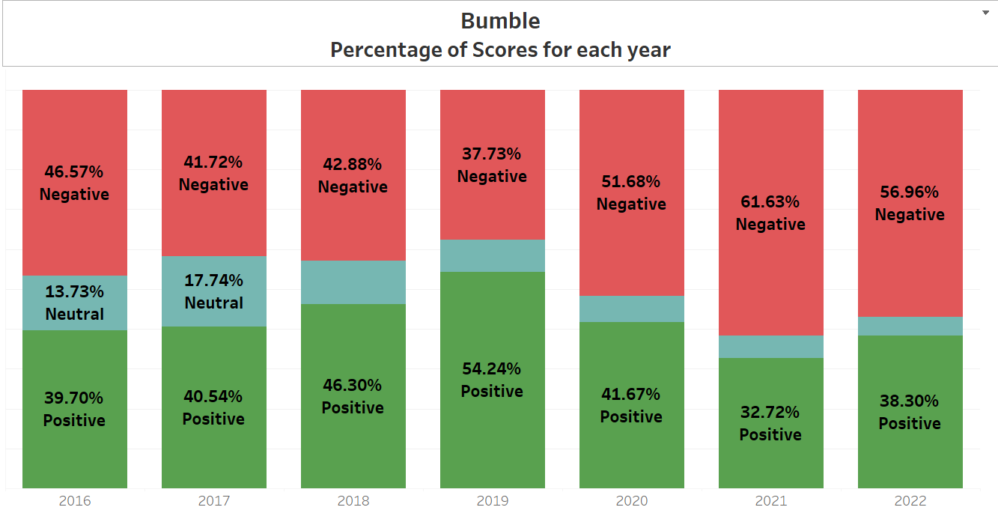

Slide 5
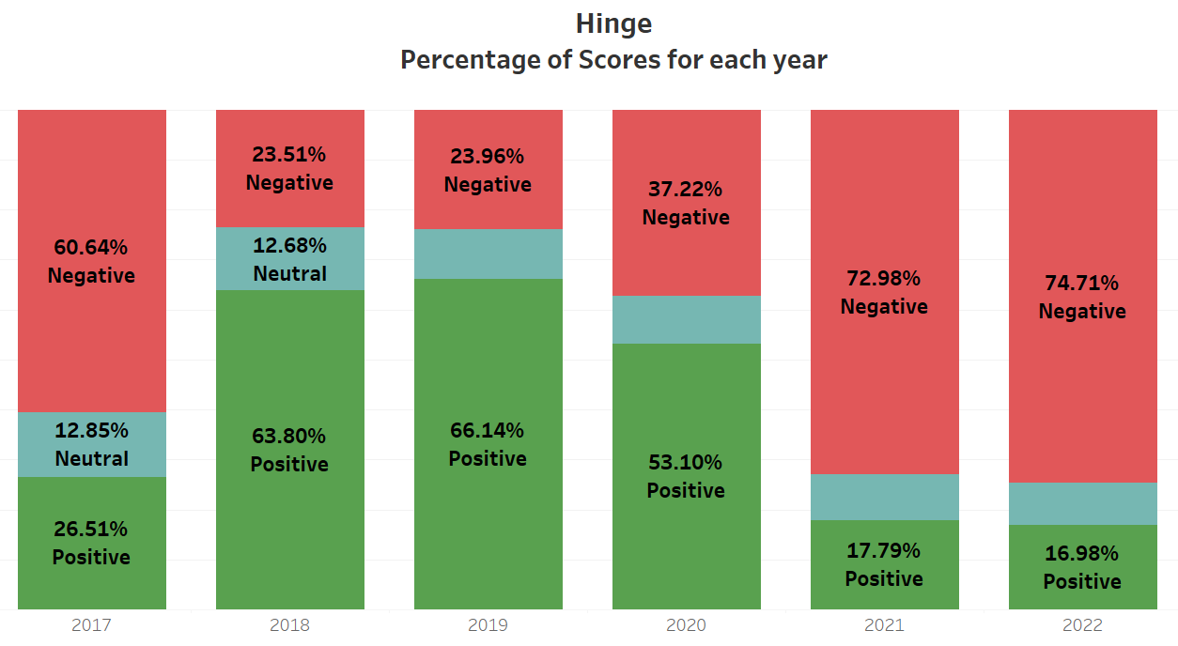

Slide 6
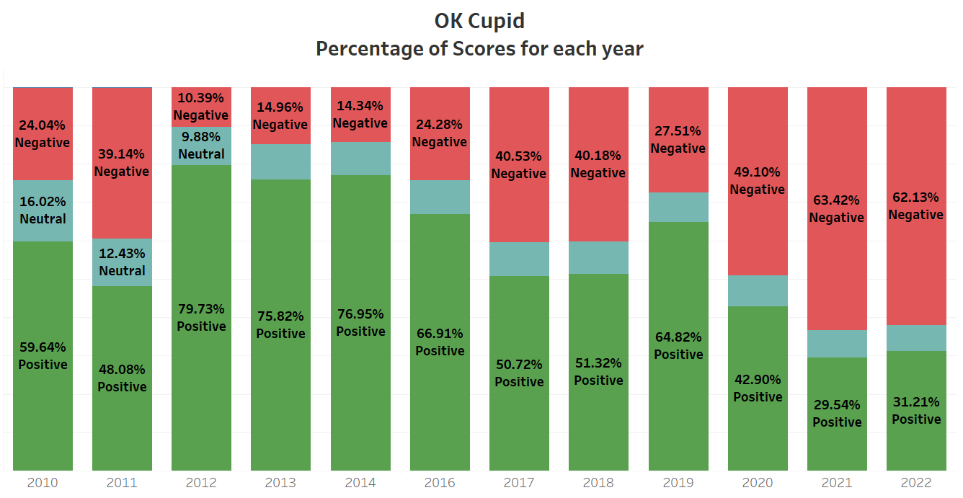

Slide 7
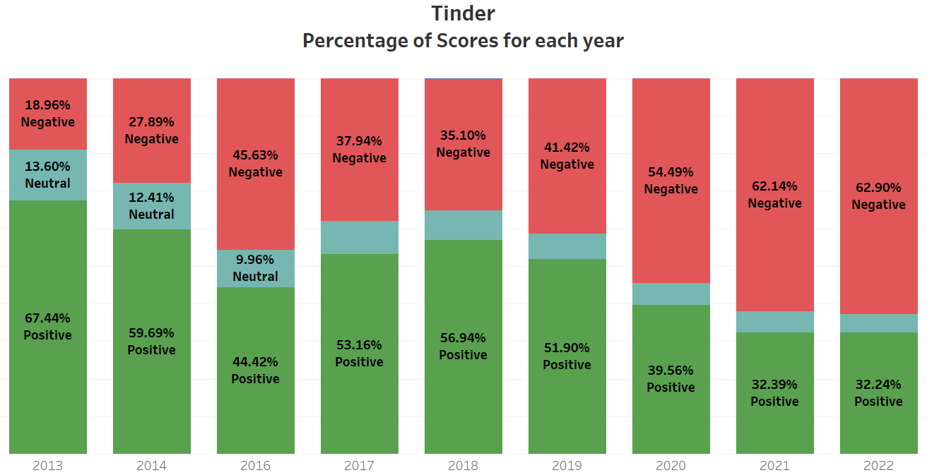

Slide 8
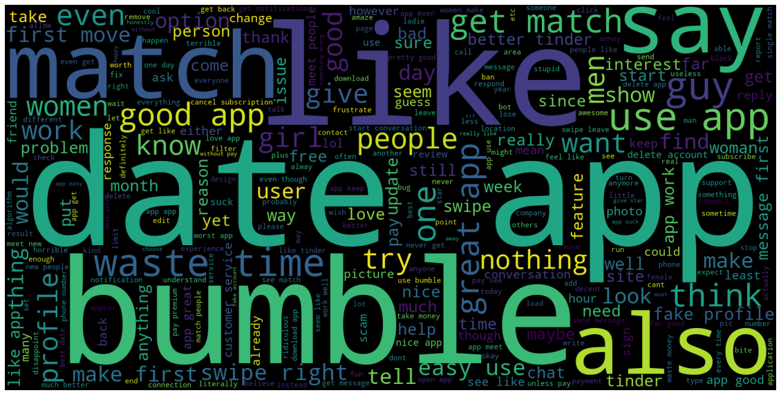
Word Cloud - Bumble

Slide 9
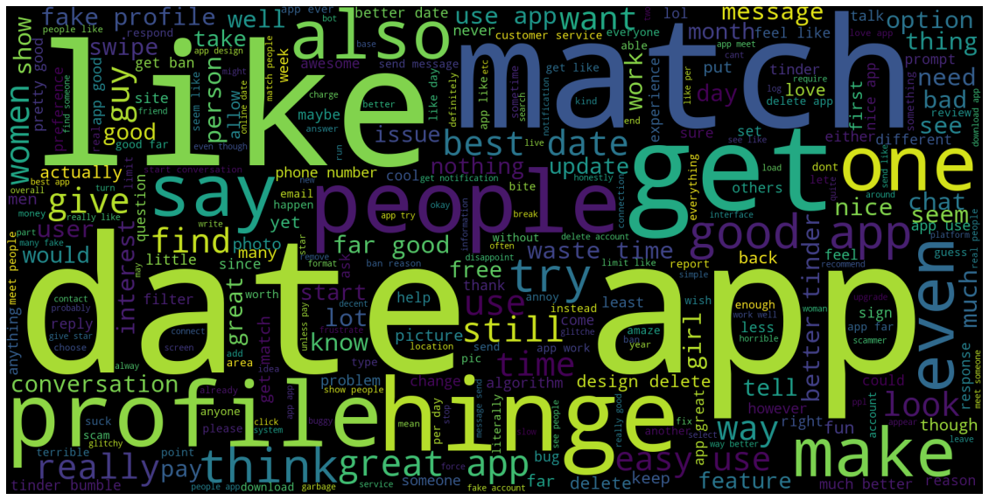
Word Cloud - Hinge

Slide 10
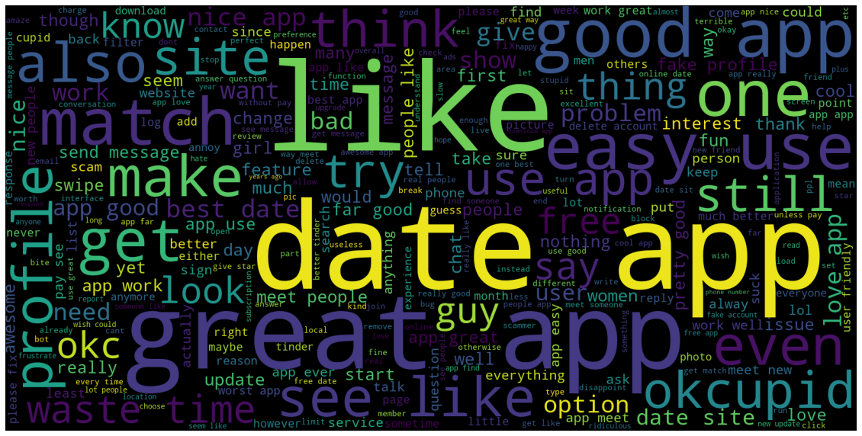
Word Cloud - OkCupid

Slide 11
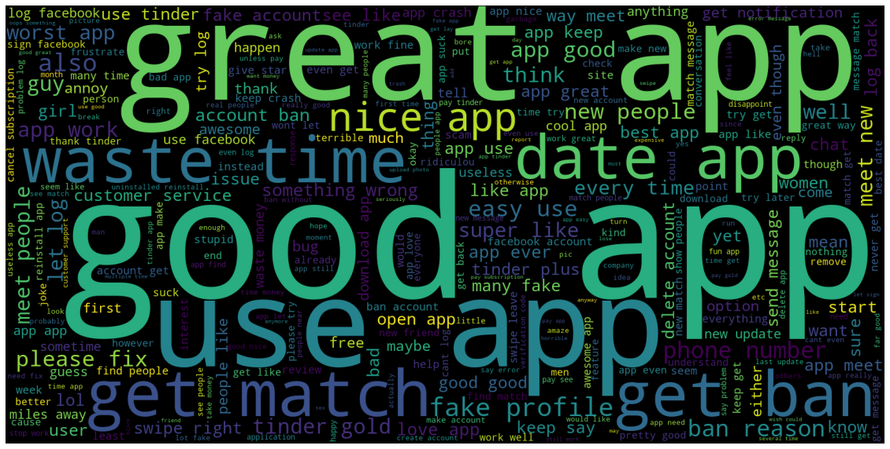
Word Cloud- Tinder

Slide 12
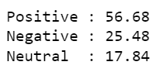
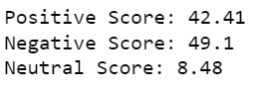
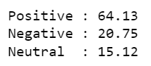
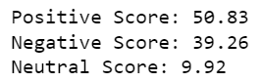
Sentimental Analysis
Bumble
Hinge

Slide 13
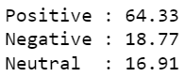
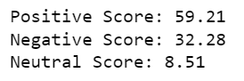
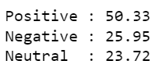
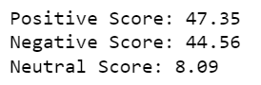
Sentimental Analysis
okCupid
Tinder

Slide 14
Future Work
References
Analyze the algorithms of these dating apps
Analyse the speed dating
Literature review - previous research
Understanding the behavioral patterns involved in making connections
Connecting with psychologist - get clear view
https://www.kaggle.com/datasets/shivkumarganesh/okcupid-google-play-store-reviews
https://www.kaggle.com/datasets/shivkumarganesh/bumble-dating-app-google-play-store-review
https://www.kaggle.com/datasets/shivkumarganesh/tinder-google-play-store-review
https://www.kaggle.com/datasets/shivkumarganesh/hinge-google-play-store-review

Slide 15


